Slide 1


Detection of Identity Theft in Critical Sectors: A Comprehensive Review
Authors: Shikhar Pandey, Dr Ali Al-Sinayyid, et al.
Affiliation: West Virginia State University
CYBERSECURITY INNOVATION CENTER

Slide 2
Introduction
WHAT IS IDENTITY THEFT?
WHICH PLACES ARE TARGETED (CRITICAL SECTOR).
WHAT MOTIVATE ME TO DO THIS RESEARCH?

Slide 3
The Core Problem
Traditional detection methods are weak.
Many states are heavily affected AND in high risk.
Influence of AI and Modern Technology.
Critical sectors need enhanced real‑time detection.

Slide 4
Current Gap
Most studies focus on big financial sectors and large institutions..
Many people are unaware of basic online safety practices
There is a lack of studies on how everyday people become targets through small, daily interactions.

Slide 5
Research Objectives
To review existing identity theft detection techniques.
Compare how well different methods work.
Find strengths and weaknesses of current approaches.
To propose future directions for stronger detection systems.

Slide 6
Methodology
Analyzed a wide range of previous research studies.
Examined the datasets used in these studies.
Evaluated the proposed algorithms based on accuracy and other matrix.
Analyzed the targeted sectors and attack types.

Slide 7
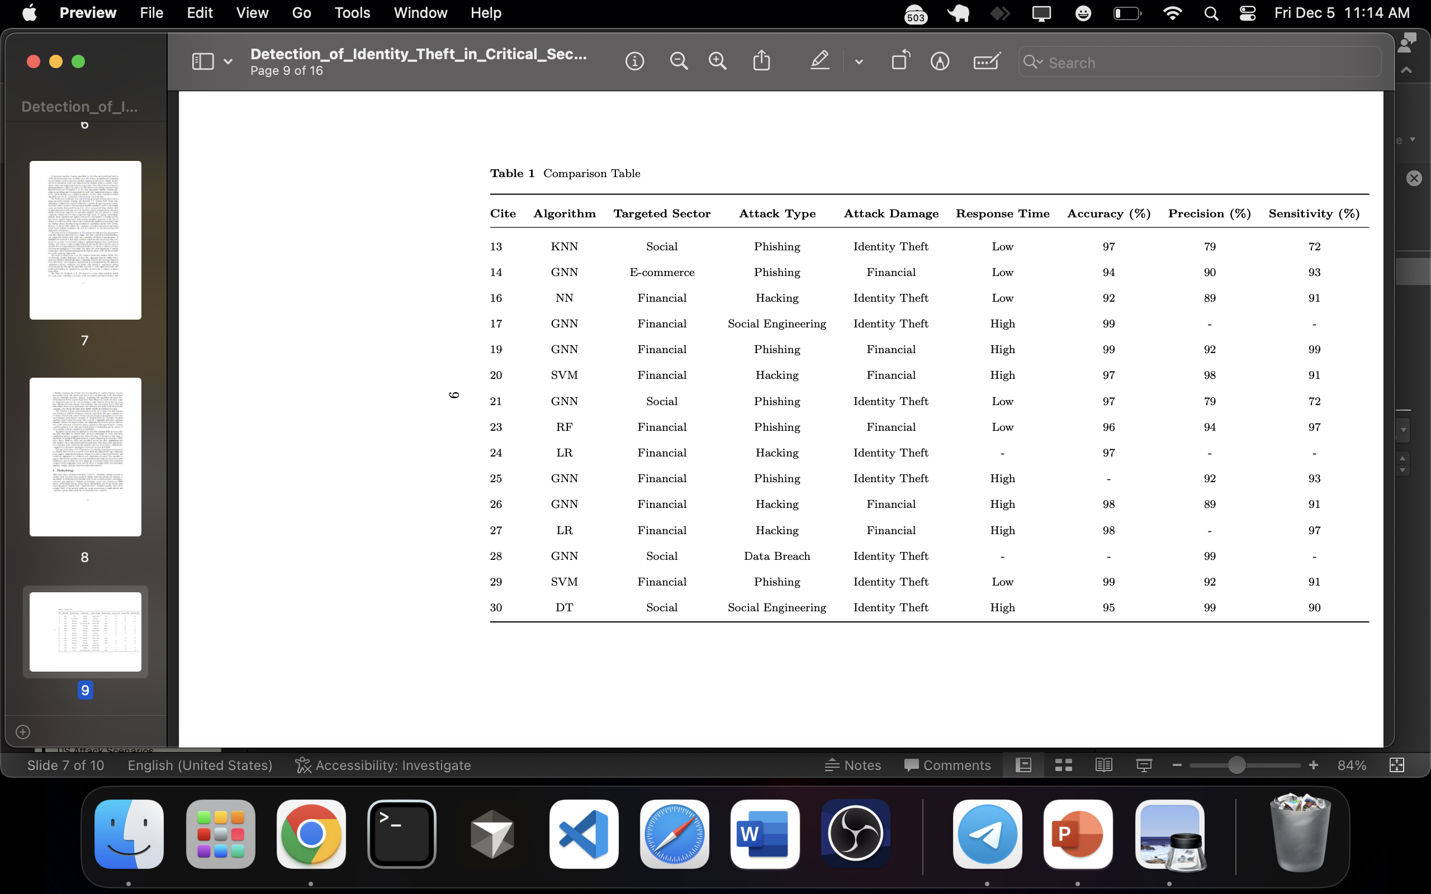

Slide 8
Key Finding
GNN = highest accuracy & sensitivity
SVM/RF = best precision
Deep Learning = good for sequence detection but high computation
Targeted sectors = financial most attacked, followed by government
Government sector = weak security, vulnerable to attacks

Slide 9
Conclusion
No single best model.
Performance depends on sector & attack.
Future: adaptive, real‑time systems.

Slide 10
CURENTLY FOCUS
Topological Data Analysis with Graph Neural Networks to detect complex and evolving identity theft threats that traditional machine learning methods often fail to identify, targeting both large sectors and local communities in real time By using Quants mathematical xmodel.

Slide 11
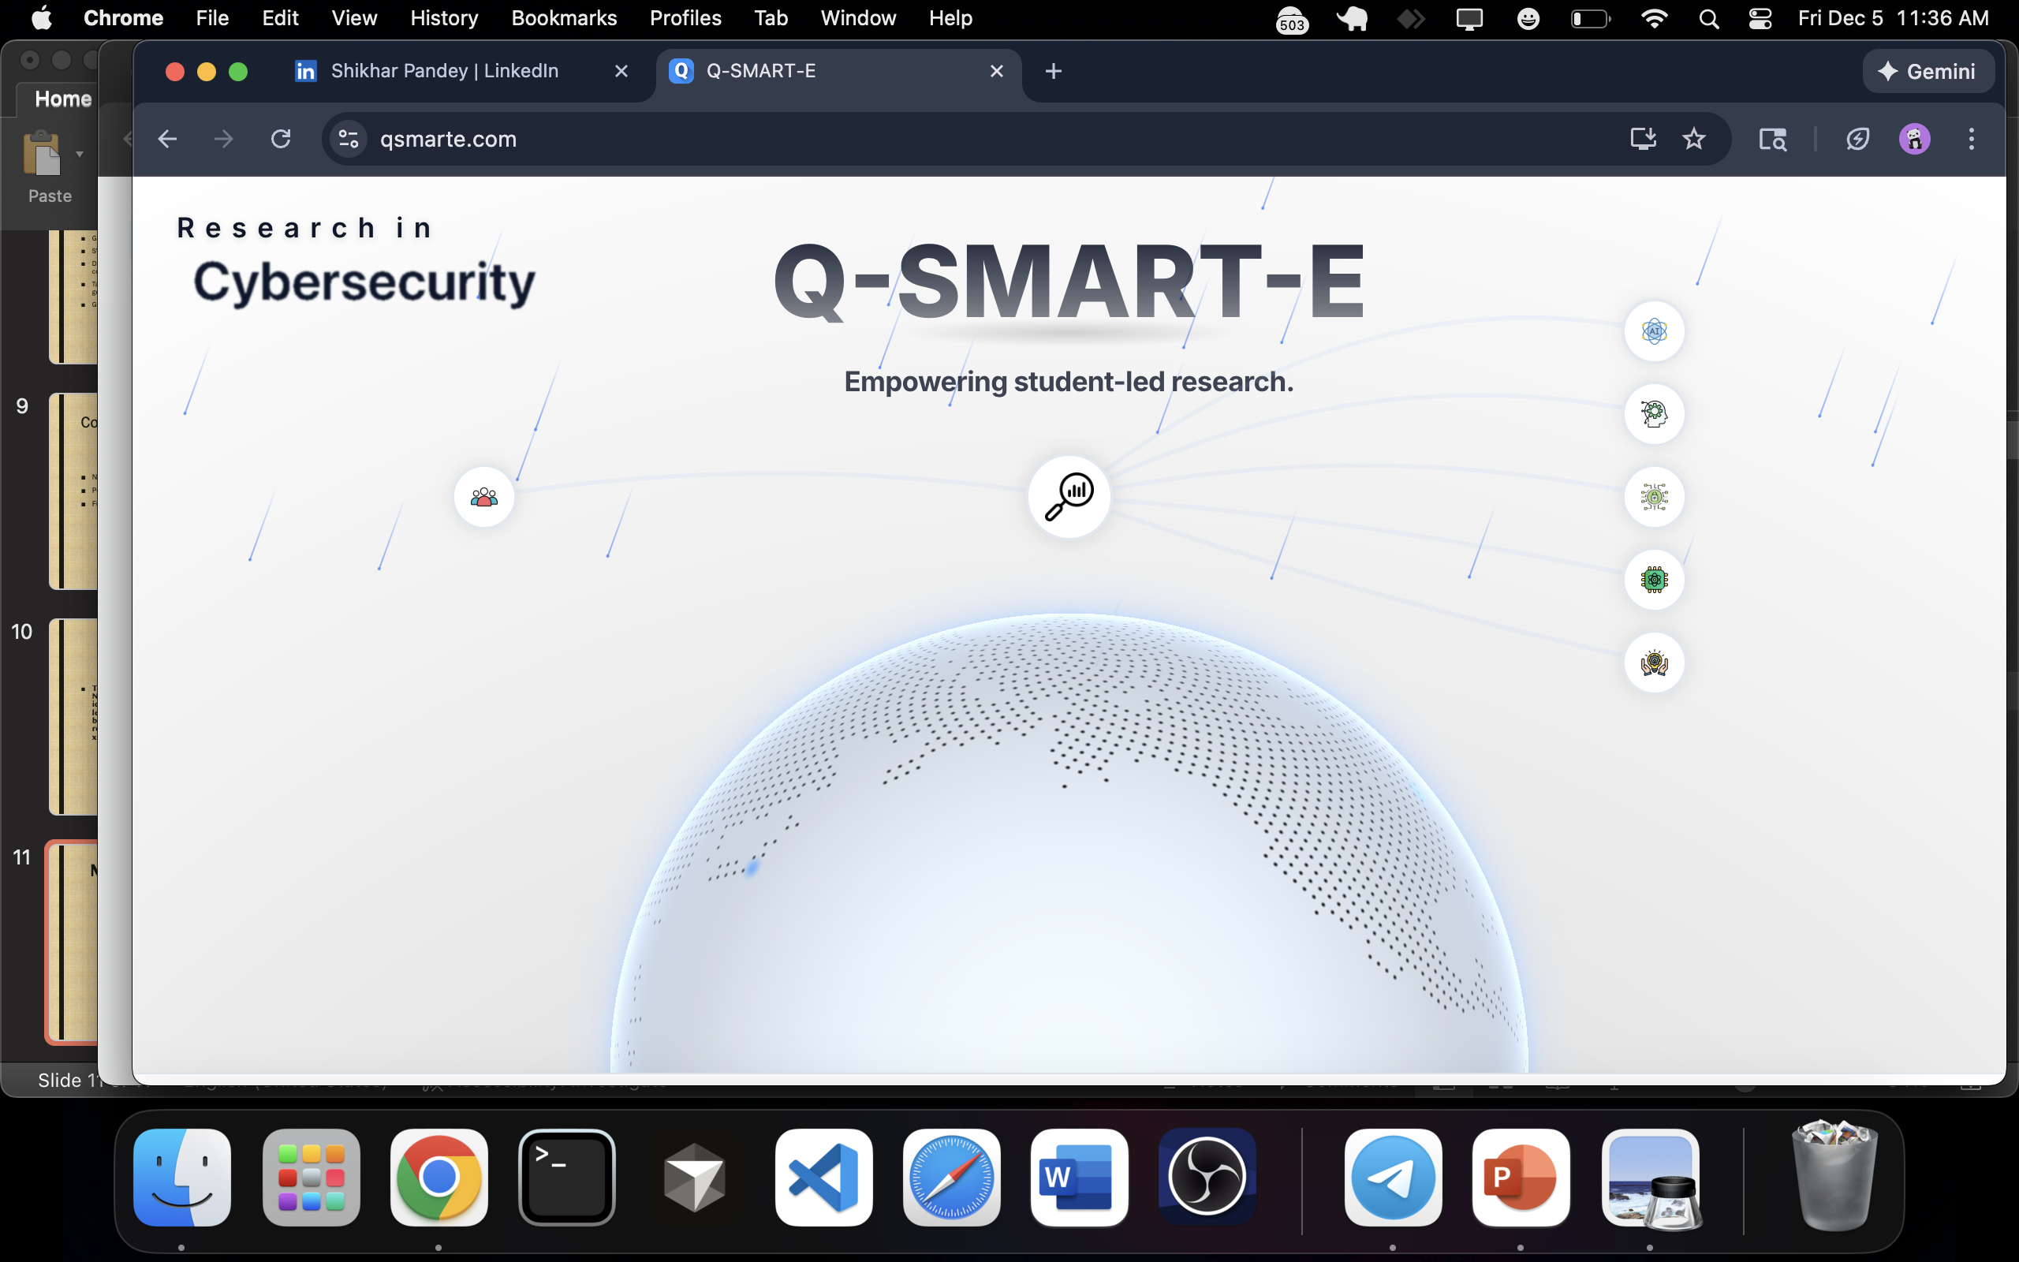
WWW.QSMARTE.COM
Q‑SMART‑E is a virtual 8-week program designed for recent high school graduates, mentoring them to undertake research projects in next-generation technologies like AI, cybersecurity, and quantum computing.
MY CONTRIBUTION

Slide 12
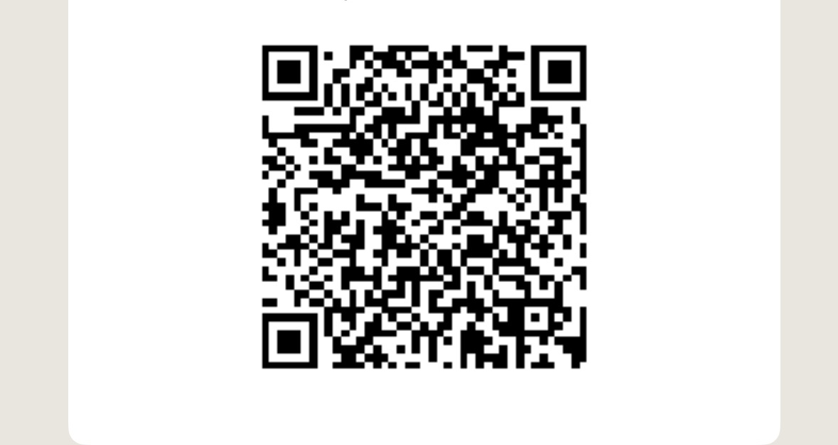
For Collaboration
spandey@wvstateu.edu
Comments / Suggestions / Questions

Slide 13
THANK YOU
Ali Al-Sinayyid
ali.alsinayyid@wvstateu.edu
Shikhar Pandey
spandey@wvstateu.edu

